Slide 1



Connecting The Dots - Showing Relationships in Data and Beyond
Marc Streit¹, Hans-Jörg Schulz², Alexander Lex³
VisWeek Tutorial 2012
Johannes Kepler University Linz, Austria
University of Rostock, Germany
Harvard School of Engineering and Applied Sciences, Cambridge, MA, USA

Slide 2
Part I: What To Link?
Speaker: Hans-Jörg Schulz

Slide 3
Linking What Belongs Together
Fulfilling the criterion of being expressive, we want to link “stuff” that it is
Related, Associated, Connected, Affiliated,…
“When two objects, qualities, classes, or attributes, viewed together by the mind, are seen under some connexion, that connexion is called a relation.” —Augustus De Morgan (1858)

Slide 4
Linking What Belongs Together
Disclaimer: There appear to be cases in which the opposite is useful/done.
The EIRTEE*-Scenario
*Everything-Is-Related-To-Everything-Else

Slide 5
Relations
Definition: Relations assign true/false to a k-tuple.
Aspects to consider:
the cardinality k
the elements of the tuple
the domain in which the relation is defined

Slide 6
Relations: Cardinality
Cases:
k=0: tautology (TRUE) + contradiction (FALSE)
k=1: unary (property)
k=2: binary (is not necessarily a 1:1 relation!)
k>2: n-ary with n>2

Slide 7
Relations: Elements
We define relations over (some part of) data.
We assume a simple hierarchical data model:
{attrib₁,…,attrib_{i}} = data item
{item₁,…,item_{j}} = data cluster
{cluster₁,…,cluster_{k}} = data set
{set₁,…,set_{l}} = data landscape
The tuple elements are drawn from these levels.

Slide 8
Relations: Elements
A set of elements is defined by a granularity and a scope.
While the granularity defines the level of detail of the relation, scope defines its extent.
For example, relations can be established between data clusters (granularity), which are drawn either from an individual data set or from multiple data sets of a data landscape (scope).
Relation Scope level > Relation Granularity

Slide 9
Relations: Domain
While the relation is defined over the data domain, it may stem from any of the following:
Data Domain
View Domain
Interaction Domain
To identify the original Relationship Domain can sometimes be hard: Is data related because it is jointly interacted with, or is it jointly interacted with because it is related?

Slide 10
Relations put Together
Domain
Data
View
Interaction
Cardinality
binary
n-ary with n>2
Elements = Granularity + Scope
Data attributes
Data items
Data clusters
Data sets
Data landscape

Slide 11
Relationships: Other Aspects
Inherent vs. Derived
Transitivity, Directionality, Strength
Multiple relationships Example: coauthorship, citation, co-citation,…
Running between different
Data tuples, Data tables, Data bases
Graphical objects, Views, Applications

Slide 12
Relationships: Interrelations
Under certain circumstances, it is possible to transform relationships. For example:
n-ary relations on data item level → binary relations on data cluster level
(via the 1:n inclusion relation between items and cluster)

Slide 13
Relationships: Interrelations
Under certain circumstances, it is possible to transform relationships. For example:
n-ary relations on data item level → binary relations on data cluster level
relations derived from interaction domain → relations from data domain, if interaction logs are considered as additional data set
(via the 1:n inclusion relation between items and cluster)

Slide 14
Relationships: Examples
Example # | Description | Domain | Granularity | Scope | Cardinality
1 | ARGOIs | Data | Attributes | Data set | binary
2 | Graphs | Data | Items | Data set | binary
3 | Hypergraphs | Data | Items | Data set | n-ary
4 | Clustered Data | Data | Items | Data set | n-ary
5 | Matchmaker/VisBricks | Data | Clusters | Data set | binary
6 | StratomeX | Data | Clusters | Landscape | binary
7 | StratomeX: DVI | Data | Data Sets | Landscape | binary
8 | Spatial Treemaps | View | Attributes | Data set | binary
9 | Stack‘n‘Flip | Interaction | Data sets | Landscape | binary

Slide 15
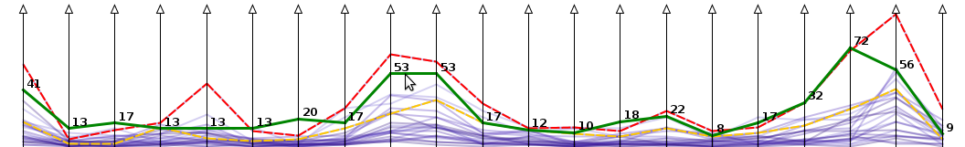
Example #1: ARGOIs
(Domain: Data, Elements: Attributes in Data Set, Cardinality: binary)
Relationship: two attributes are related, iff they belong to the same data tuple
Common visual representation: ParCoords
Image taken from Tominski+Schulz (2012)

Slide 16
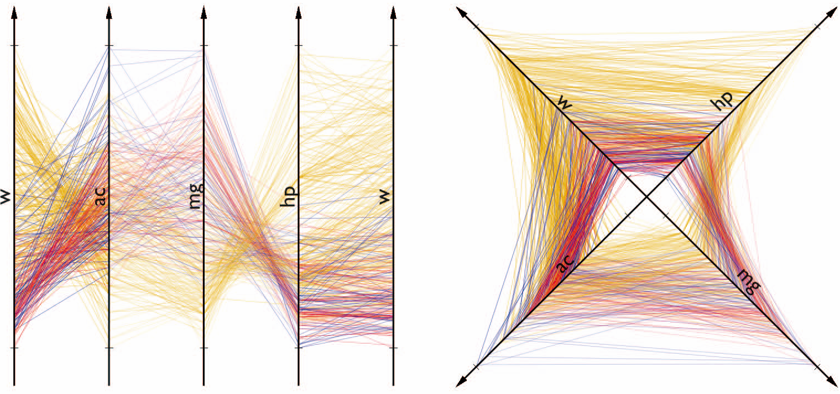
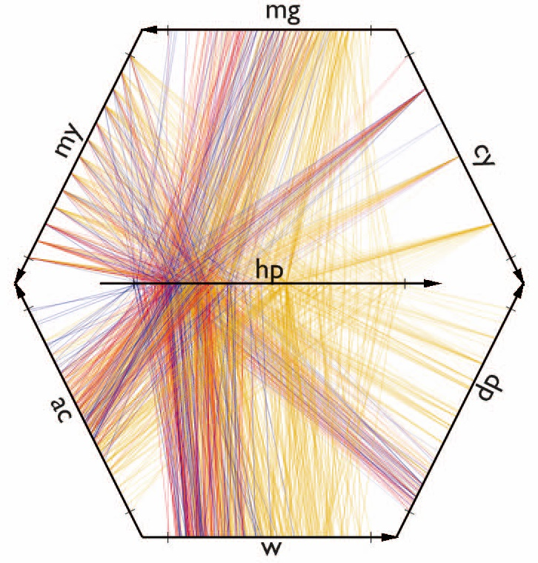
Example #1: ARGOIs
(Domain: Data, Elements: Attributes in Data Set, Cardinality: binary)
Generalization by Claessen+Wijk (2011):
A
B
C
D
A
A
B
C
B
D
Attribute Relation Graphs of Interest ARGOIs
A
D
C
G
E
F

Slide 17
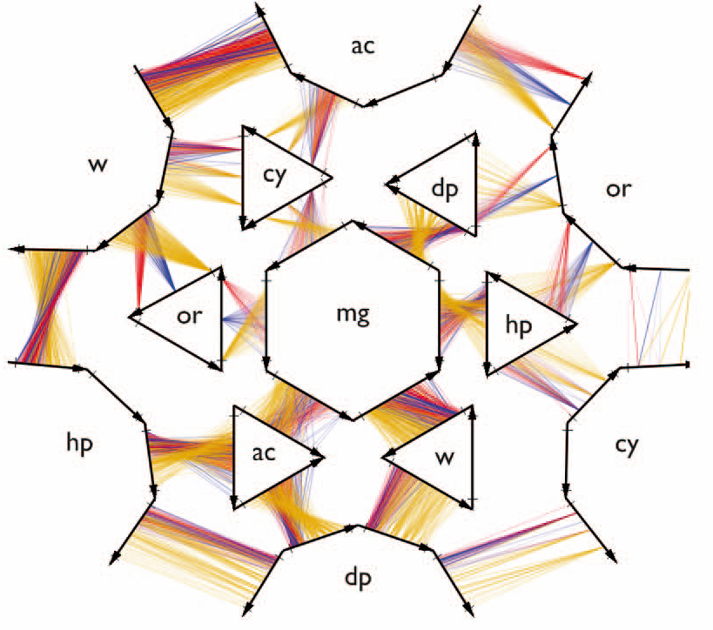
Example #1: ARGOIs
(Domain: Data, Elements: Attributes in Data Set, Cardinality: binary)
Generalization by Claessen+Wijk (2011):
G
F
B
C
D
B
A
E
G
F
E
C
D
Straight-line planarity required!
Planarity required!

Slide 18
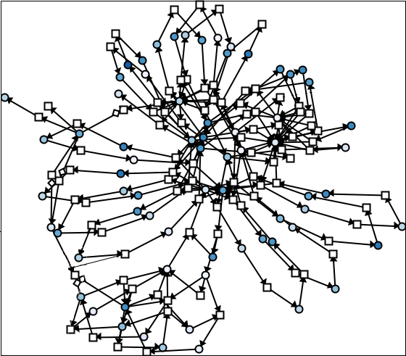
Example #2: Graphs
(Domain: Data, Elements: Items in Data Set, Cardinality: binary)
Relationship: two items are related, iff there exists an edge between them
Common visual representation: Node-Link-Diagram
Image taken from Hadlak, Schulz, Schumann (2011)

Slide 19
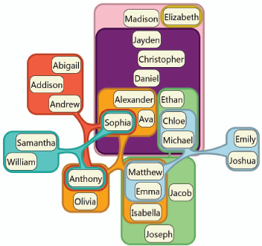
Example #3: Hypergraphs
(Domain: Data, Elements: Items in Data Set, Cardinality: n-ary)
Relationship: a number of items are related, iff there exists a hyperedge between them
Common visual representation: Euler-Diagram
Image taken from Riche+Dwyer (2010)

Slide 20
Example #3: Hypergraphs
(Domain: Data, Elements: Items in Data Set, Cardinality: n-ary)
Recall interrelationships
Hypergraphs can be transformed into regular graphs

Slide 21
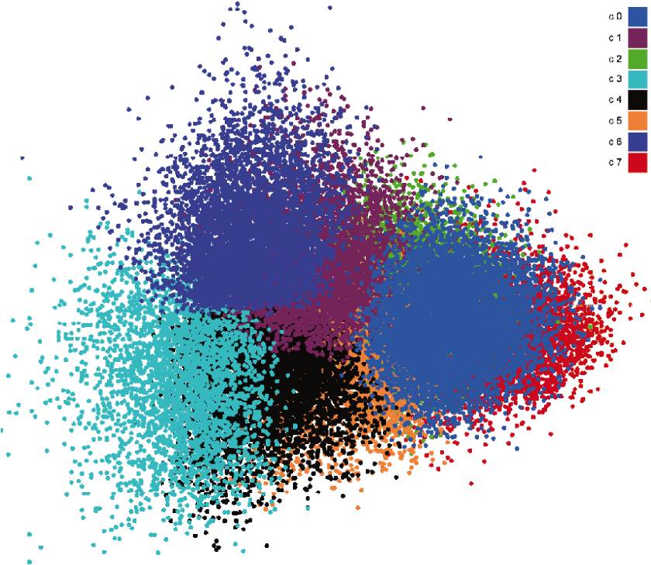
Example #4: Clustered Data
(Domain: Data, Elements: Items in Data Set, Cardinality: n-ary)
Relationship: a number of items are related, iff they belong to the same cluster
Common visual representation: Scatterplot
Image taken from Luboschik et al. (2010)

Slide 22
Example #4: Clustered Data
(Domain: Data, Elements: Items in Data Set, Cardinality: n-ary)
Clustering is the division of data into groups of similar objects.
given: a (dis-)similarity measure/matrix
n-dimensional, numerical data: Euclidean Distance
network data: Graph-theoretic Distance
strings of text: Edit Distance
sought: a grouping of the data w.r.t. that measure

Slide 23
Example #4: Clustered Data
(Domain: Data, Elements: Items in Data Set, Cardinality: n-ary)
What makes a good grouping?
Compact: elements in cluster are similar
Separated: clusters are different
Balanced: cluster membership is equally probable
Parsimonious: much fewer clusters than data objects
Source: Cosma Shalizi (2009)

Slide 24
Example #4: Clustered Data
(Domain: Data, Elements: Items in Data Set, Cardinality: n-ary)
Directionality of the clustering:
Top-down: divisive
Bottom-up: agglomerative
Linkage metrics:
Single Linkage: nearest neighbor
Complete Linkage: farthest neighbor
Average Linkage: all neighbors

Slide 25
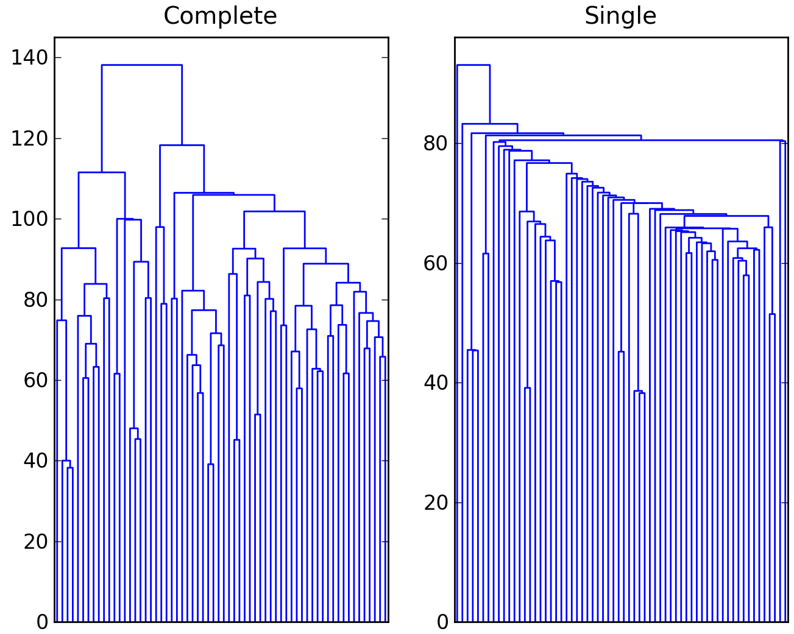
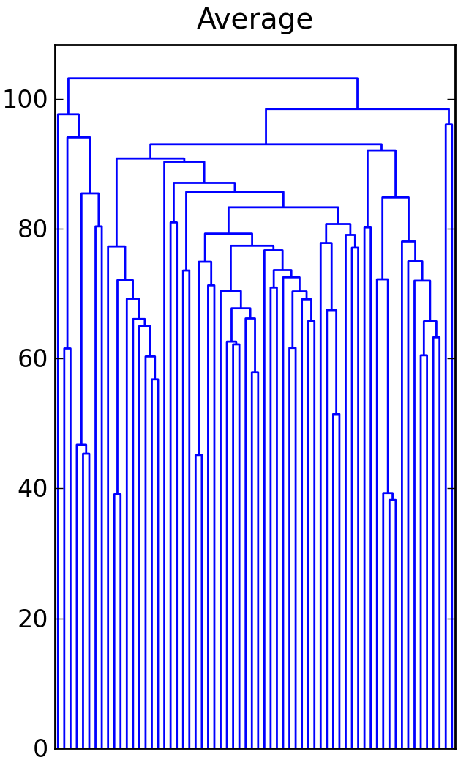
Example #4: Clustered Data
(Domain: Data, Elements: Items in Data Set, Cardinality: n-ary)
tends to construct small, evenly sized clusters
tends to construct chains of clusters
Images taken from Jonathan Taylor (2010)

Slide 26
Example #4: Clustered Data
(Domain: Data, Elements: Items in Data Set, Cardinality: n-ary)
Consensus Clustering
NP complete
Heuristics:
Quantitative/metric-based: CSPA Cluster-based Similarity Partitioning Algorithm
Structural/graph-based: HGPA Hyper-Graph Partitioning Algorithm

Slide 27
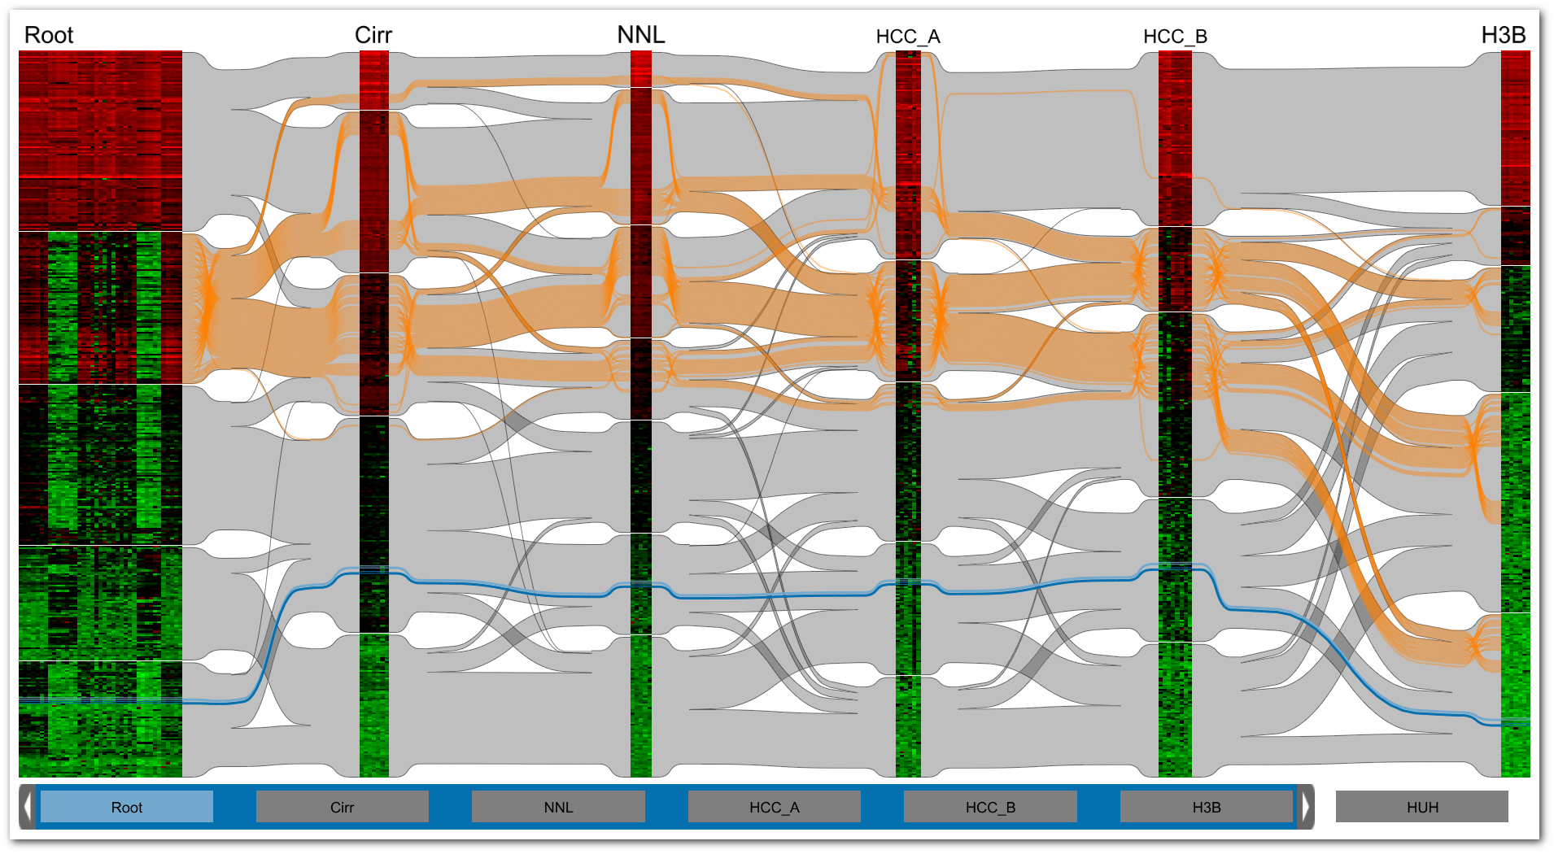
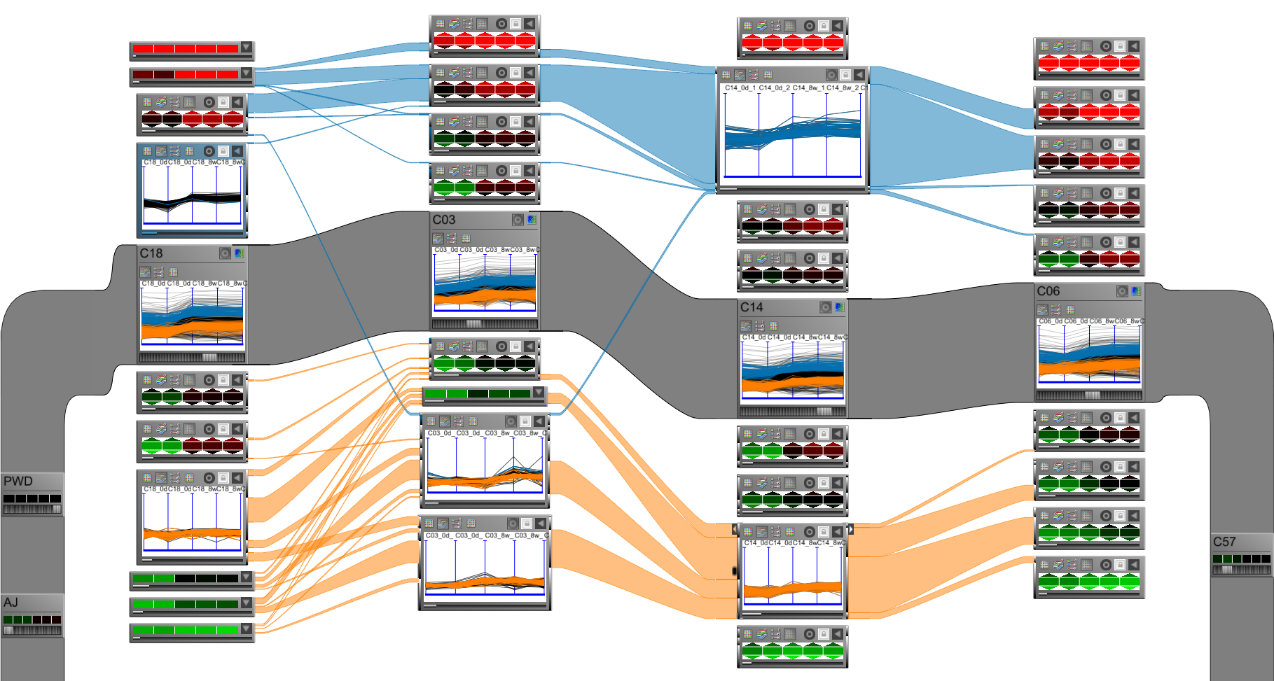
Example #5: Matchmaker/VisBricks
(Domain: Data, Elements: Clusters in Data Set, Cardinality: binary)
Relationship: two clusters are related, iff they share data items
Common visual representation: Ribbons
Image taken from Lex et al. (2010)
Image taken from Lex et al. (2011)

Slide 28
Example #5: Matchmaker/VisBricks
(Domain: Data, Elements: Clusters in Data Set, Cardinality: binary)
Matchmaker: Clusters of the whole data set
Image taken from Lex et al. (2010)

Slide 29
Example #5: Matchmaker/VisBricks
(Domain: Data, Elements: Clusters in Data Set, Cardinality: binary)
VisBricks: Clusters of dimensional subsets
Image taken from Lex et al. (2011)

Slide 30
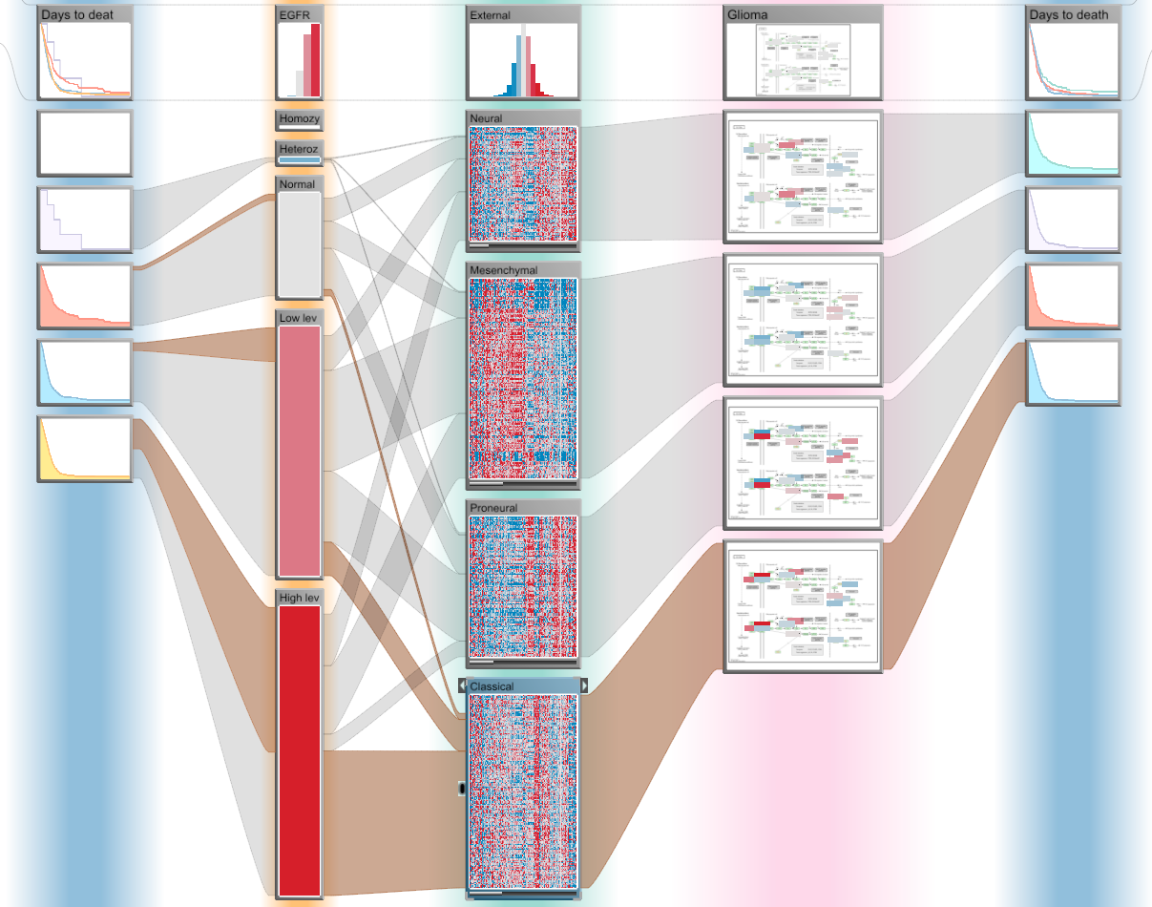
Example #6: StratomeX
(Domain: Data, Elements: Clusters in Landscape, Cardinality: binary)
Relationship: two clusters are related, iff they contain data with the same keys (IDs)
Common visual representation: Ribbons
Image taken from Lex et al. (2012)

Slide 31
Example #6: StratomeX
(Domain: Data, Elements: Clusters in Landscape, Cardinality: binary)
StratomeX: Clusters of different data sets
Image taken from Lex et al. (2012)

Slide 32
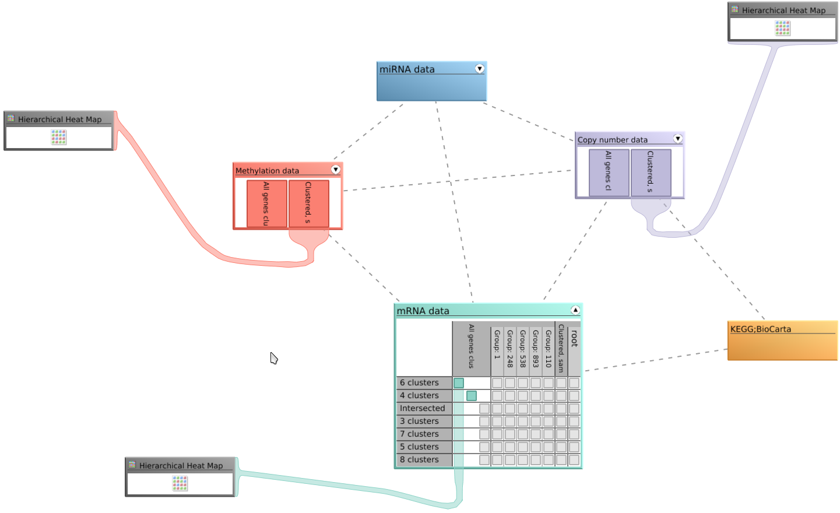
Example #7: StratomeX DVI
(Domain: Data, Elements: Data Sets in Landscape, Cardinality: binary)
Relationship: two data sets are related, iff they contain data with the same keys (IDs)
Common visual representation: Graph
Image taken from Lex et al. (2012)

Slide 33
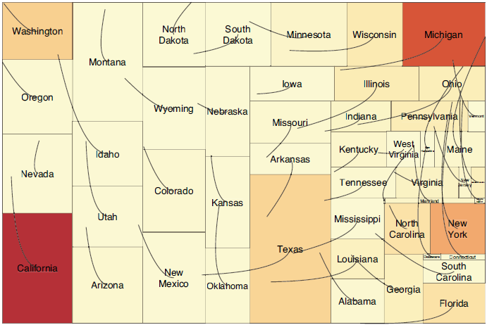
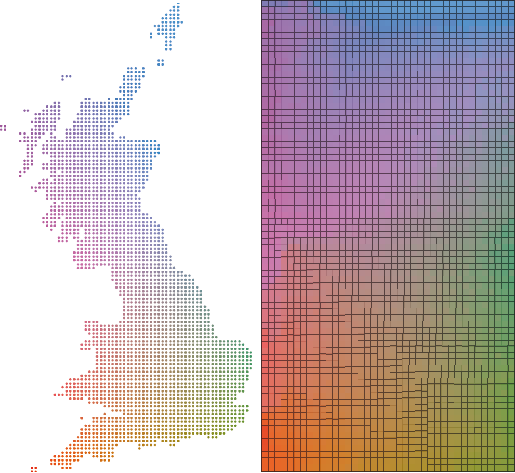

Example #8: Spatial Treemaps
(Domain: View, Elements: Attributes of Data Items, Cardinality: binary)
Relationship: two spatial positions are related, iff they both belong to the same data item
Common visual representation: Strokes and/or Color
Images taken from Wood+Dykes (2008)

Slide 34
Example #8: Spatial Treemaps
(Domain: View, Elements: Attributes of Data Items, Cardinality: binary)
Lines
Image taken from Wood+Dykes (2008)

Slide 35
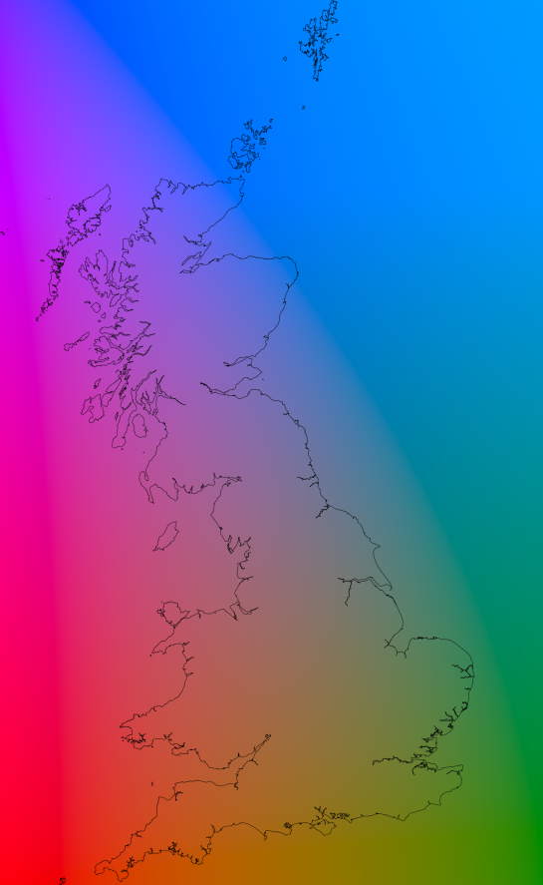
Example #8: Spatial Treemaps
(Domain: View, Elements: Attributes of Data Items, Cardinality: binary)
Color
Images taken from Wood+Dykes (2008)

Slide 36
Example #8: Spatial Treemaps
(Domain: View, Elements: Attributes of Data Items, Cardinality: binary)
Color+Lines
Images taken from Wood+Dykes (2008)

Slide 37
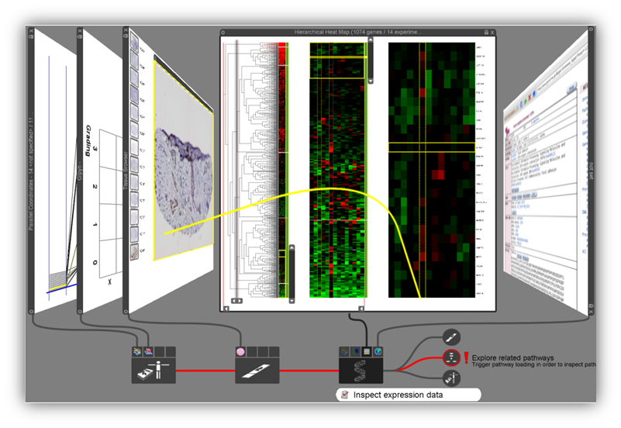
Example #9: Stack’n’Flip
(Domain: Interaction, Elements: Data Sets in Landscape, Cardinality: binary)
Relationship: two data sets are related, iff they are used in sequence
Common visual representation: Graph
Image taken from Streit et al. (2012)

Slide 38
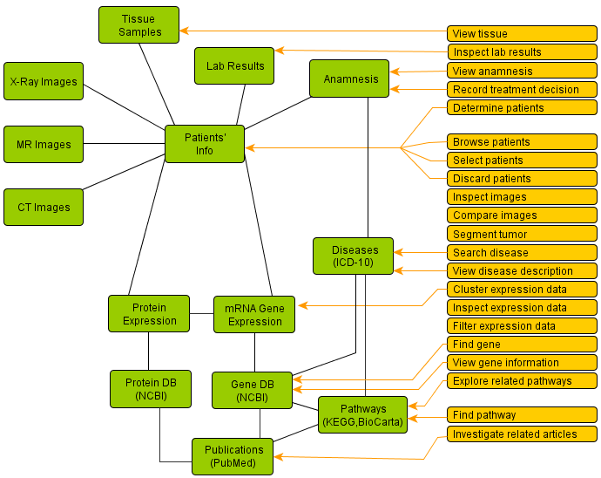
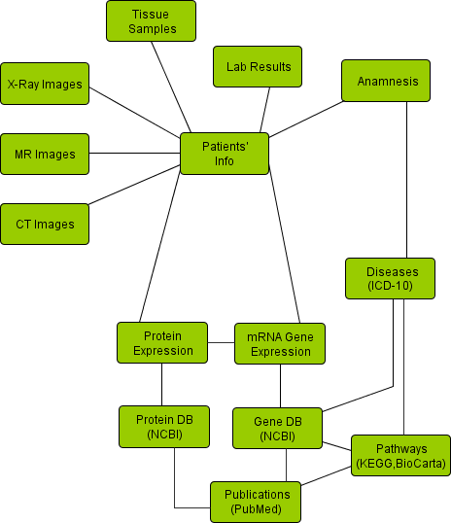
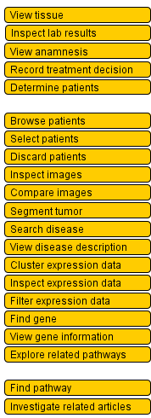
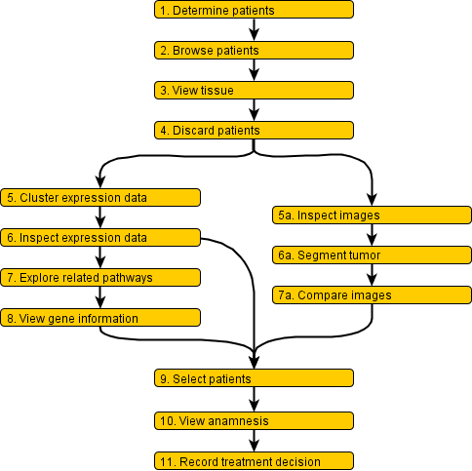
Example #9: Stack’n’Flip
(Domain: Interaction, Elements: Data Sets in Landscape, Cardinality: binary)
Images taken from Streit et al. (2012)

Slide 39
Example #9: Stack’n’Flip
(Domain: Interaction, Elements: Data Sets in Landscape, Cardinality: binary)
Image taken from Streit et al. (2012)

Slide 40
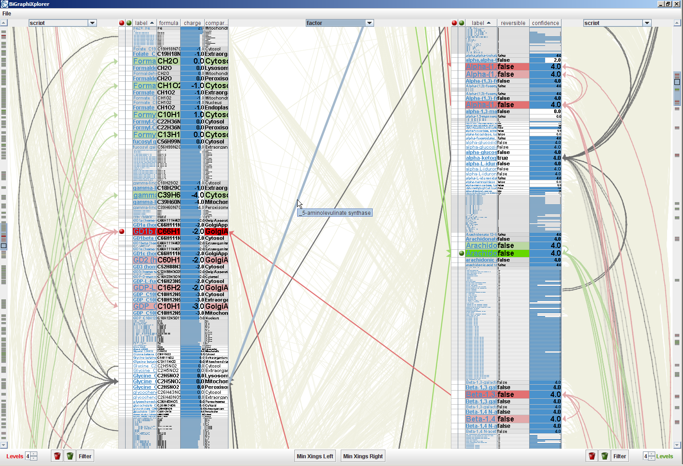
Edge-based Traveling
Using Relations for Interaction
Clicking an edge with one off-screen end leads automatically towards it
Tooltip indicates details about the off-screen node
Image taken from Schulz et al. (2008)

Slide 41
What to do with a relation?
Represent in data space: e.g., multidimensional data → graph → use standard graph visualization
Represent in view space:
This is what “Part 2: How to Link” is all about!

Slide 42
Summary of Part I: What to Link?
Relations differ in their
Cardinality
Elements (Granularity + Scope)
Domain
Relations can be derived or inherent
Examples given show what‘s already been done
– AND WHAT‘S STILL LEFT TO EXPLORE

